Slide 1
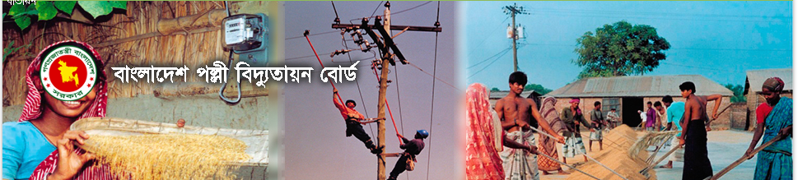
PRESENTATION ON
Different Types Of Communication used in Smart Metering System with advantage & disadvantage
09 December,2021
Mahmud Munim
Network Engineer,ICT,BREB

Slide 2
Content
Overview of Prepaid Smart Metering System.
Different communications media overview and comparison among them based on Rural Electrification scenario.
Communication media proposal for Rural Electrification System.
Recommendation to select comunication media for Rural
Electrification System.
Advantage of Prepaid Smart Metering in Rural Electrification System.

Slide 3
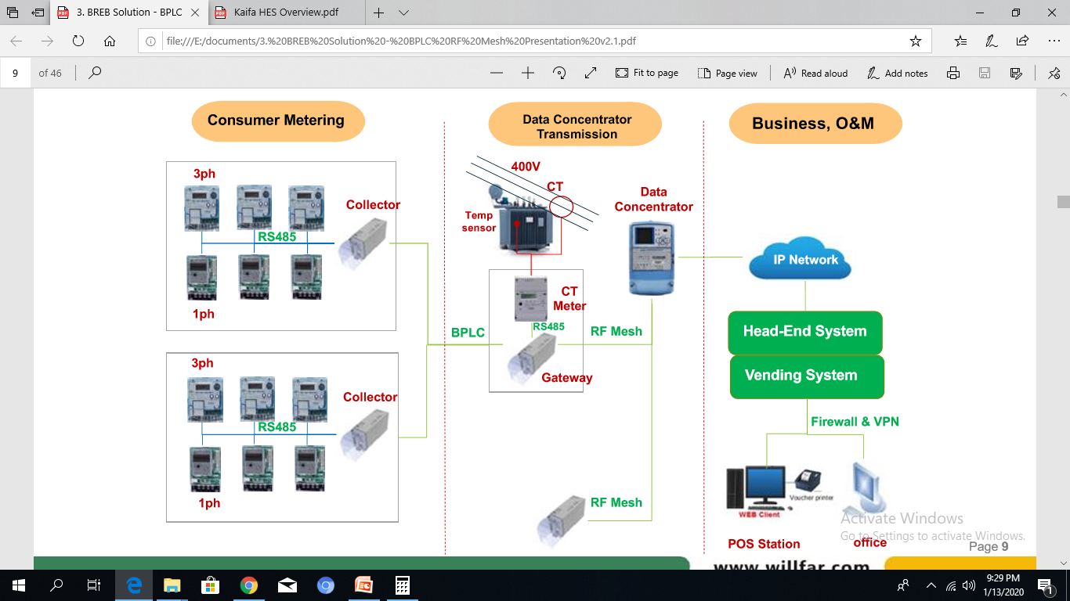

Overview of Smart Metering System
PLC
Office

Slide 4
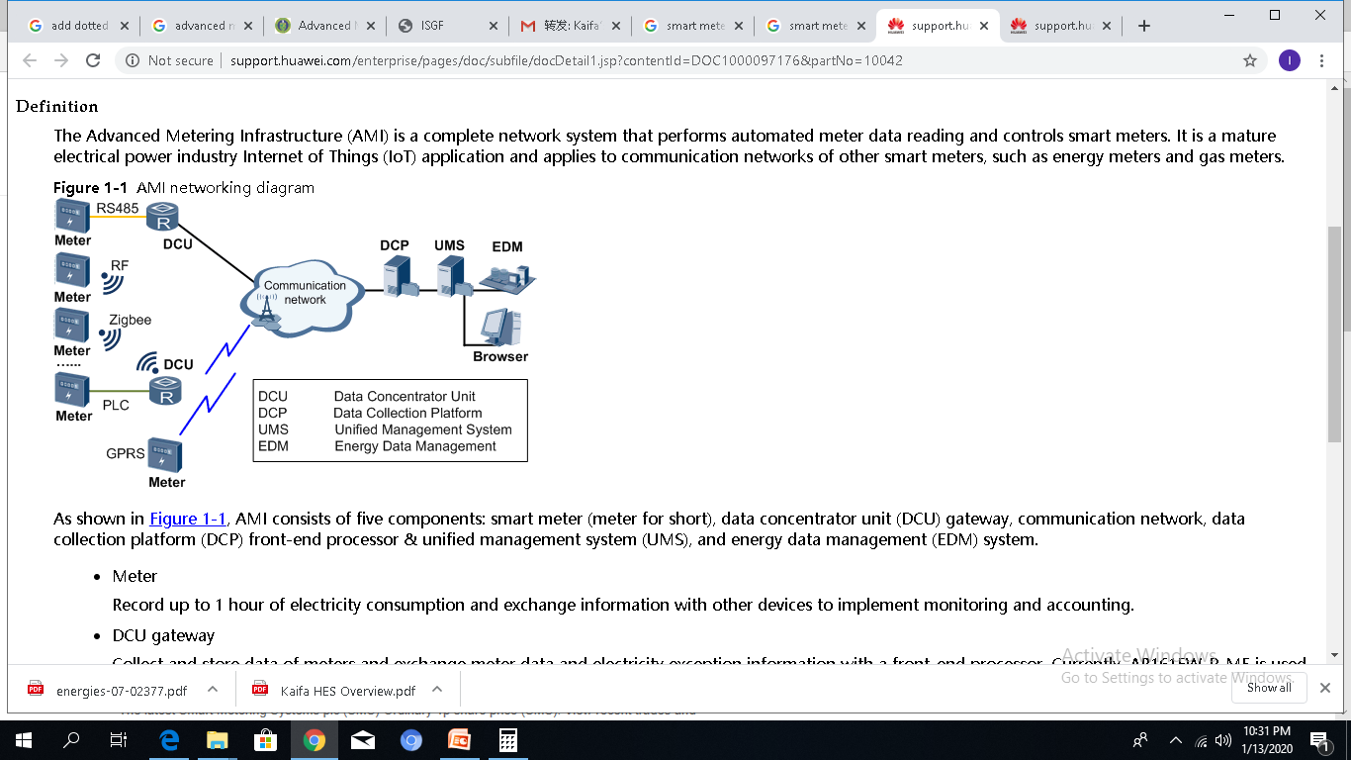
Working Procedure of Smart Metering System
Communication
GPRS: 3G
Easy troubleshooting
expensive
PLC: G3-PLC
Good grid environment
low noise disturbing and signal attenuating
High maintenance cost
RF: RF mesh
Broadcast Remotely
RF mesh to make less DCU
DCU
Data concentrators collect data about energy consumption and other customer management information from smart meters connected via a wireless or power-line communication (PLC)
Module
HES
MDM
Billing
Meter
HES
Load Control.
Schedule Meter Reading .
Communication Analysis.
Group Programming.
Event Collection.
Demand Side Management.
MDM
Loss Management
Anti-tampering
Monitoring analysis
Custom report

Slide 5
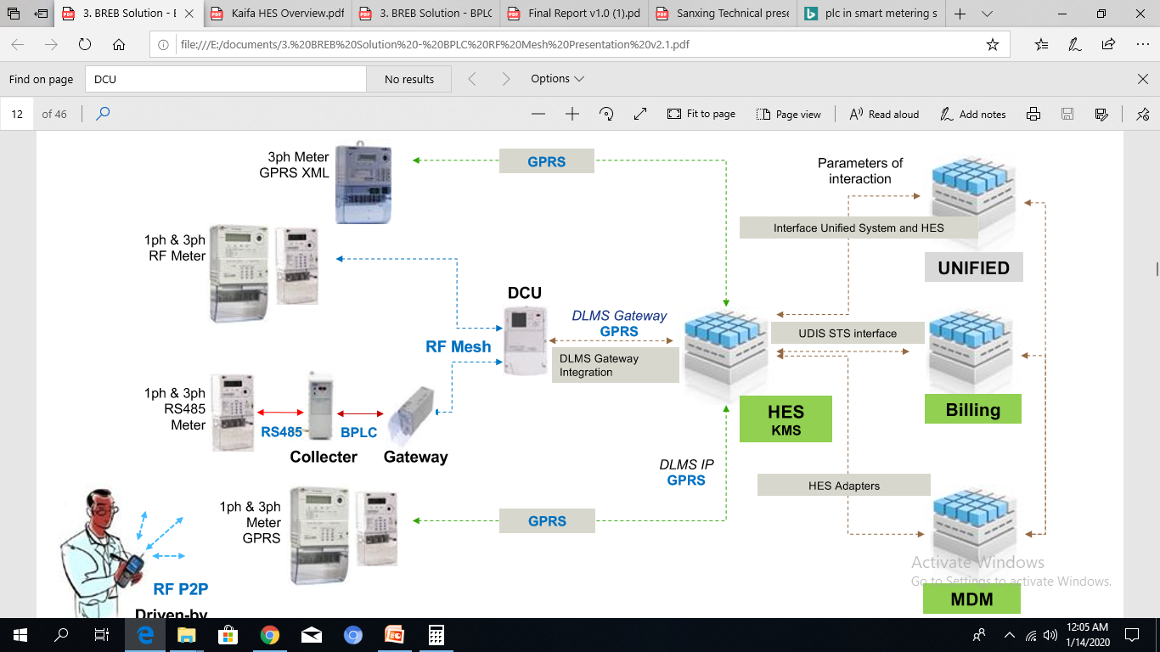
Communications scenario on Rural Electrification System.
DLMS G
DLMS G
DL
HES
PLC
MDM

Slide 6
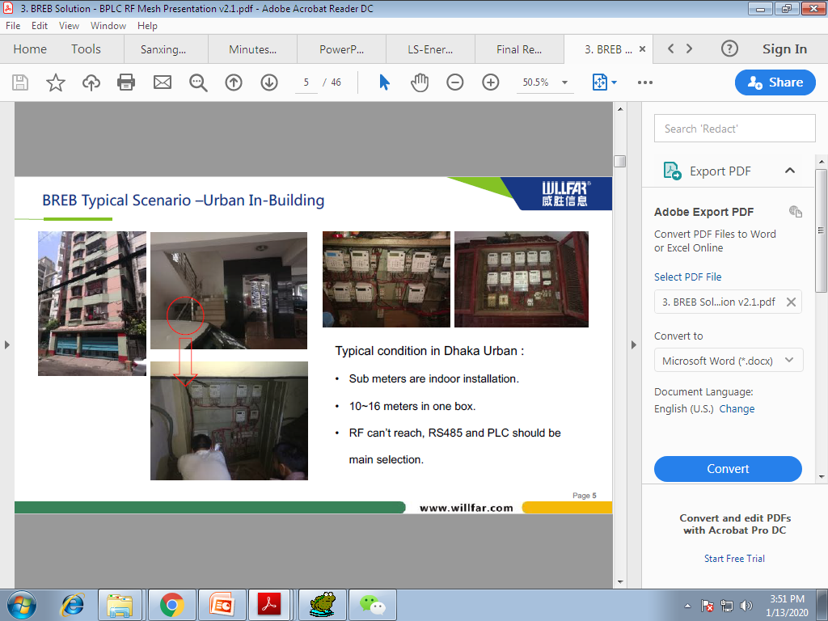

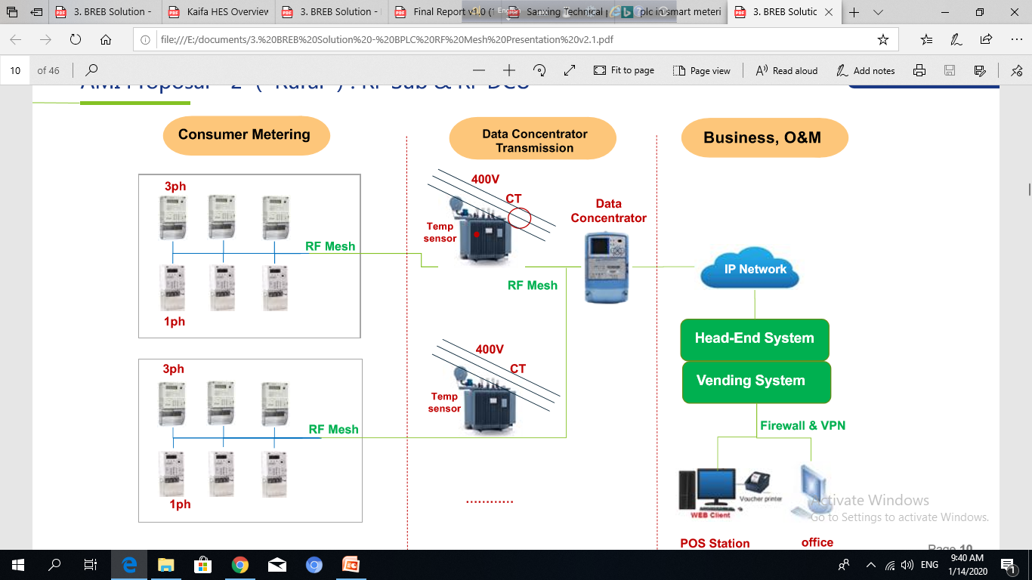

Real Scenario in PBS: 1 Proposal 1: PLC/RS-485
HES (server located in BREB)
G3-PLC ( Communication media)
Inside in building where RF or GPRS will not work properly.
In this scenario G3-PLC or RS-485 is suitable for data exchange.
DCU
Smart meter

Slide 7
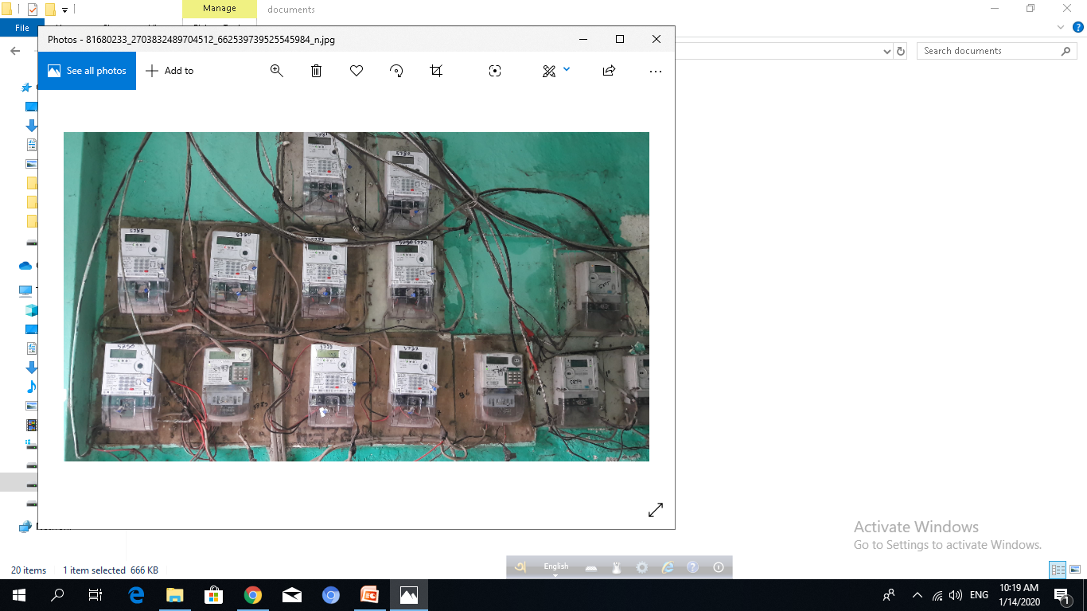

Real Scenario in PBS: 2 Proposal 2: RF-Mesh
HES (server located in BREB)
RF-Mesh (Communication media)
Large number of consumer within 1 or 1.5 km area where high raise building is not available.
In this case RF-Mesh is suitable for data exchange.
PLC / GPRS is costly in this case because need more SIM card/DCU to implement communication structure.
Smart meter

Slide 8
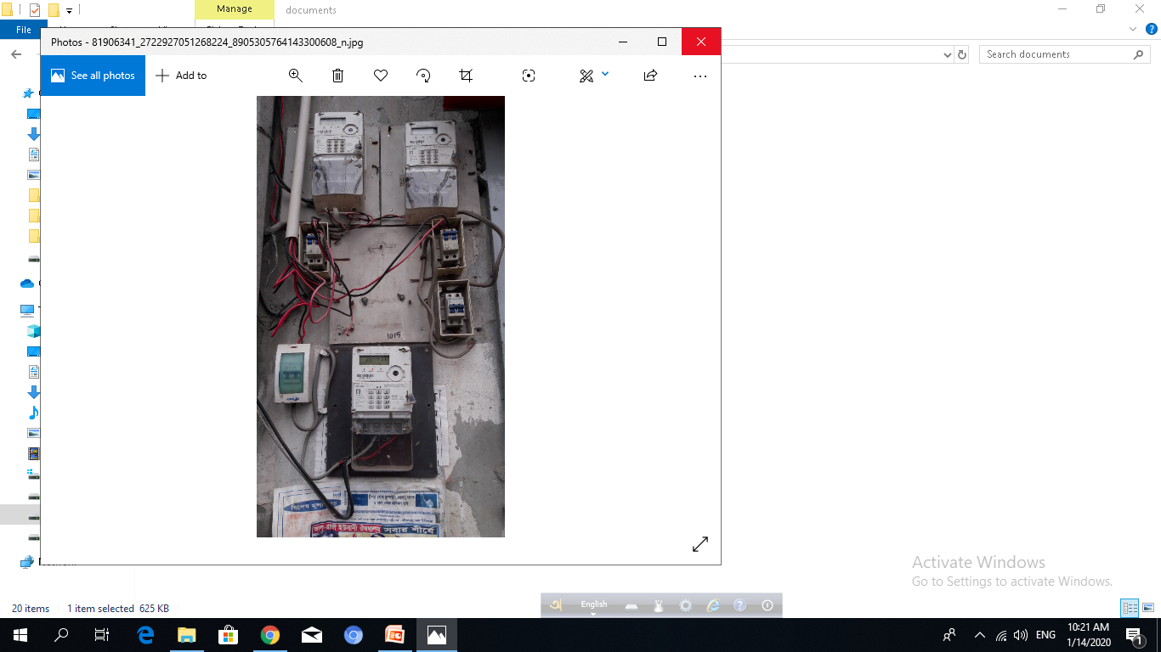
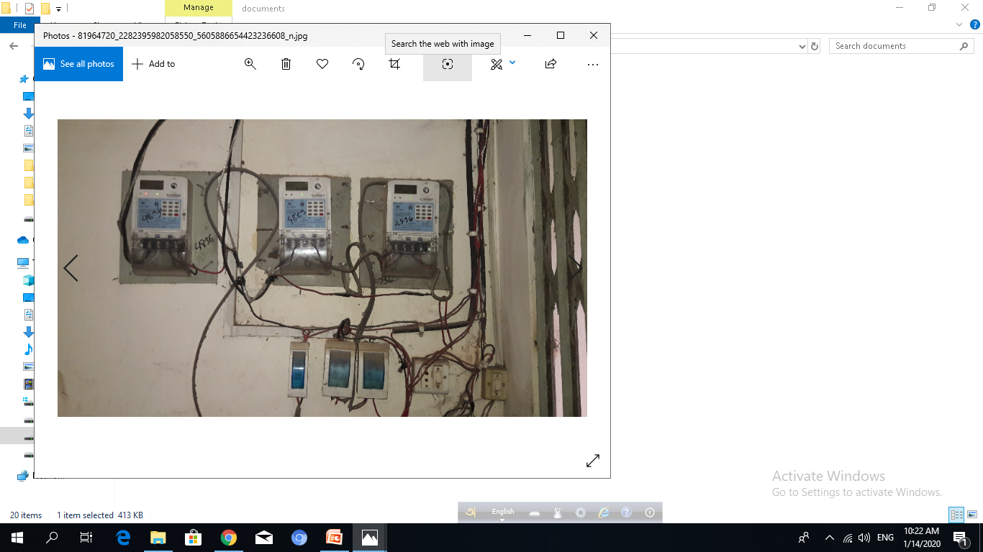

Real Scenario in PBS: 3 Proposal 3: GPRS
HES (server located in BREB)
GPRS (Communication media)
Small number of consumer in 1 or 1.5 km area.
In this case GPRS is suitable for data exchange.
PLC / RF is costly in this case because need more DCU to implement communication structure.
Smart meter

Slide 9
Thanks

